Slide 1
Artificial Intelligence
By
Sakin Jan

Slide 2
Artificial intelligence (AI)
AI is a subdivision of computer science devoted to creating computer software and hardware that imitates the human mind.
Making Computers More Useful by making them smarter by using AI.
We call programs ‘intelligent’ if they exhibit behaviors that would be regarded as intelligent if they were exhibited by human beings – Herbert Simon
Artificial intelligence (AI) is the ability of a computer or a robot controlled by a computer to do tasks that are usually done by humans because they require human intelligence and discernment
Word AI is credited to John McCarthy (1956)
Will human be replaced?
NO. The idea is not to replace human being but to provide them with useful and powerful tools to assist them in their work.

Slide 3
Definitions: AI
Artificial Intelligence is a branch of Science which deals with helping machines find solutions to complex problems in a more human-like fashion.
This generally involves borrowing characteristics from human intelligence, and applying them as algorithms in a computer friendly way.
The main purpose of AI is to make computers smarter, more powerful and thus more useful.

Slide 4
What is intelligence?
Perceive the world around us? Eat when hungry? Pick a spot of shade to avoid sun? sense danger and flee, or fight if escape is not possible?
Goal oriented behavior? Such behavior requires collection and organization of large amounts of knowledge.
But forgetting unimportant things is also a part of intelligent behavior.
Computers have no knowledge of their existence.

Slide 5
Intelligence
The ability to acquire knowledge and apply it.
The capability of thinking and reasoning .
The ability to learn or understand or to deal with new or trying situations
The ability to easily learn or understand things or to deal with new or difficult situations
Is there any level of intelligence?
Is computer an intelligent machine?
Microsoft Autocorrect--> is it intelligent?

Slide 6
Is computer an intelligent machine?
A. No. Intelligence involves mechanisms, and AI research has discovered how to make computers carry out some of them and not others. If doing a task requires only mechanisms that are well understood today, computer programs can give very impressive performances on these tasks.

Slide 7
Turing Test and Chinese Room Argument
‘A’-Evaluator has no idea if he/she is talking to a computer
Gets Chinese symbols as input, use the rule book and return the Chinese symbols as output.
Q. Does he understand Chinese language?

Slide 8
ELIZA
ELIZA is an early natural language processing computer program created from 1964 to 1966 at MIT by Joseph Weizenbaum.
ELIZA that passed the Turing test
Pickup speech patterns from the user’s questions and providing responses using those patterns
Main Characteristics
Simulation of intelligence—no intelligent + no understanding + just simulate
Quality of response – limited available template
Coherence – sentence based with no coherence to the previous conversation
Semantic– no Semantic representation

Slide 9
History of Artificial Intelligence
Artificial Intelligence is not a new word and not a new technology for researchers. This technology is much older than you would imagine. Even there are the myths of Mechanical men in Ancient Greek and Egyptian Myths. Following are some milestones in the history of AI which defines the journey from the AI generation to till date development.

Slide 10
Maturation of Artificial Intelligence (1943-1952)
Year 1943: The first work which is now recognized as AI was done by Warren McCulloch and Walter pits in 1943. They proposed a model of artificial neurons.
Year 1949: Donald Hebb demonstrated an updating rule for modifying the connection strength between neurons. His rule is now called Hebbian learning.
Year 1950: The Alan Turing who was an English mathematician and pioneered Machine learning in 1950. Alan Turing publishes "Computing Machinery and Intelligence" in which he proposed a test. The test can check the machine's ability to exhibit intelligent behavior equivalent to human intelligence, called a Turing test.

Slide 11
The birth of Artificial Intelligence (1952-1956)
Year 1955: An Allen Newell and Herbert A. Simon created the "first artificial intelligence program"Which was named as "Logic Theorist". This program had proved 38 of 52 Mathematics theorems, and find new and more elegant proofs for some theorems.
Year 1956: The word "Artificial Intelligence" first adopted by American Computer scientist John McCarthy at the Dartmouth Conference. For the first time, AI coined as an academic field.
At that time high-level computer languages such as FORTRAN, LISP, or COBOL were invented. And the enthusiasm for AI was very high at that time.

Slide 12
The golden years-Early (1956-1974)
Year 1966: The researchers emphasized developing algorithms which can solve mathematical problems. Joseph Weizenbaum created the first chatbot in 1966, which was named as ELIZA.
Year 1972: The first intelligent humanoid robot was built in Japan which was named as WABOT-1.

Slide 13
The first AI winter (1974-1980)
The duration between years 1974 to 1980 was the first AI winter duration. AI winter refers to the time period where computer scientist dealt with a severe shortage of funding from government for AI researches.
During AI winters, an interest of publicity on artificial intelligence was decreased.
A boom of AI (1980-1987)

Slide 14
A boom of AI (1980-1987)
Year 1980: After AI winter duration, AI came back with "Expert System". Expert systems were programmed that emulate the decision-making ability of a human expert.
In the Year 1980, the first national conference of the American Association of Artificial Intelligence was held at Stanford University.

Slide 15
The second AI winter (1987-1993)
The duration between the years 1987 to 1993 was the second AI Winter duration.
Again Investors and government stopped in funding for AI research as due to high cost but not efficient result. The expert system such as XCON was very cost effective.

Slide 16
Emergence of intelligent agents (1993-2011)
Year 1997: In the year 1997, IBM Deep Blue beats world chess champion, Gary Kasparov, and became the first computer to beat a world chess champion.
Year 2002: for the first time, AI entered the home in the form of Roomba, a vacuum cleaner.
Year 2006: AI came in the Business world till the year 2006. Companies like Facebook, Twitter, and Netflix also started using AI.

Slide 17
Deep learning, big data and artificial general intelligence (2011-present)
Year 2011: In the year 2011, IBM's Watson won jeopardy, a quiz show, where it had to solve the complex questions as well as riddles. Watson had proved that it could understand natural language and can solve tricky questions quickly.
Year 2012: Google has launched an Android app feature "Google now", which was able to provide information to the user as a prediction.
Year 2014: In the year 2014, Chatbot "Eugene Goostman" won a competition in the infamous "Turing test."
Year 2018: The "Project Debater" from IBM debated on complex topics with two master debaters and also performed extremely well.
Google has demonstrated an AI program "Duplex" which was a virtual assistant and which had taken hairdresser appointment on call, and lady on other side didn't notice that she was talking with the machine.

Slide 18
Components of AI Program
Knowledge base
KB is based on facts and rules
Voluminous in nature and require proper structuring
May be incomplete and imprecise
May be dynamic and keep on changing
Control Strategy
Which rule to be applied
To know this rule, some heuristics or thumb rule based on problem domain may be applied
Inference Mechanism
Requires search through the KB
Derives new knowledge using the existing knowledge with the help of inference rule.

Slide 19
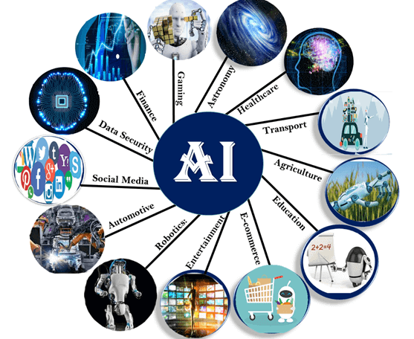
Application of artificial intellegence

Slide 20
Application of artificial intellegence
AI in Automotive Industry
Some Automotive industries are using AI to provide virtual assistant to their user for better performance. Such as Tesla has introduced TeslaBot, an intelligent virtual assistant.
Various Industries are currently working for developing self-driven cars which can make your journey more safe and secure.
AI in Entertainment
We are currently using some AI based applications in our daily life with some entertainment services such as Netflix or Amazon. With the help of ML/AI algorithms, these services show the recommendations for programs or shows.

Slide 21
Application of artificial intellegence
AI in Gaming
AI can be used for gaming purpose. The AI machines can play strategic games like chess, where the machine needs to think of a large number of possible places.
AI in Finance
AI and finance industries are the best matches for each other. The finance industry is implementing automation, chatbot, adaptive intelligence, algorithm trading, and machine learning into financial processes.

Slide 22
Application of artificial intellegence
AI in Astronomy
Artificial Intelligence can be very useful to solve complex universe problems. AI technology can be helpful for understanding the universe such as how it works, origin, etc.
AI in Healthcare
Healthcare Industries are applying AI to make a better and faster diagnosis than humans. AI can help doctors with diagnoses and can inform when patients are worsening so that medical help can reach to the patient before hospitalization.

Slide 23
Conventional VS AI Computing
Conventional computers uses algorithms for data storage and retrieval, calculation, control and other processing functions.
AI is a software that consist of knowledge base and a mechanism that solves problems and make decisions by search and pattern matching techniques.

Slide 24
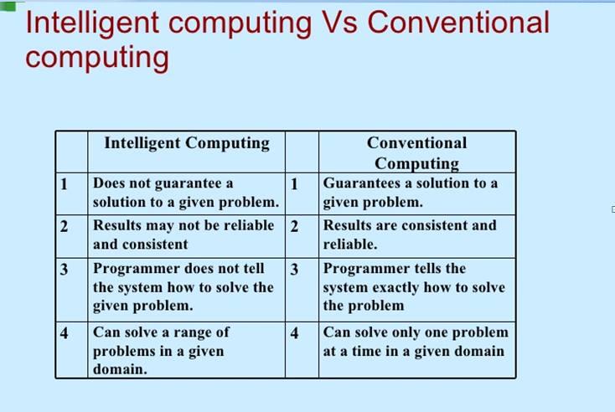

Slide 25
Topics in AI
Knowledge representation
Natural language processing
Expert system
Robotics
Machine learning
Fuzzy logic and fuzzy sets
Machine translation
Neural networks
Pattern recognition

Slide 26
Thanks and Questions!!

Slide 27
Assignment 1
1. Define the following terms. How does it work?
Swarm Intelligence (250 words)
Ant Colony Algorithm (250 words)
2. Suggest the different step for constructing Tic-tac-toe game.
All assignments should be submitted in groups.
Deadline : 13th Sept, 2018, 11.00 AM (in class)
2. Use ELIZA program and discuss it in the class.

